Slide 1
Analytics Roles, Consumers and Designers
Yoel Kortick – Senior Librarian

Slide 2

Contents
  Introduction
  Analytics Roles
  Analytics Consumers
  Analytics Designers

Slide 3

Introduction

Slide 4
Introduction
Access to Alma Analytics may be divided into two types:
Access by the designer who can create , edit, delete., etc. reports and other entities
Access by the consumer who can view the report as part of dashboard, as a standalone report, receive by email a scheduled report, or view a widget on her or his Alma landing page.

Slide 5

Analytics Roles

Slide 6
Analytics Roles
There are two roles related specifically to Analytics:
Analytics Administrator
  Manages Alma Analytics configuration including Analytics Objects List, Analytics User Statistics, and Analytics Citation Attribute Types.
Designs Analytics
  Permitted to design, create, edit, delete and work on any analytics reports, analysis, dashboards etc., as well as Data Visualization projects.

Slide 7
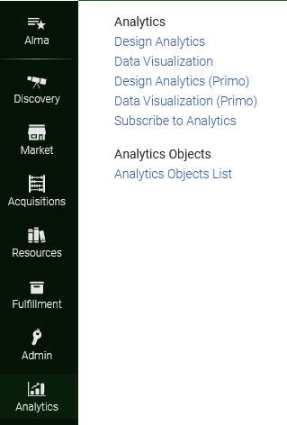
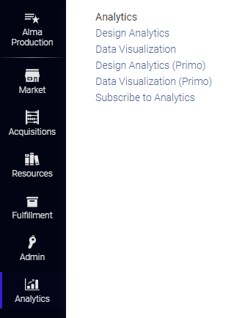
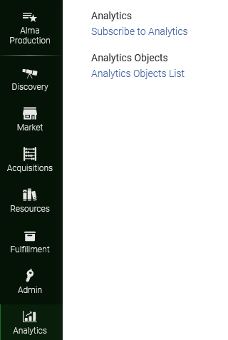
Analytics Roles
A user with both roles “Analytics Administrator” and “Designs Analytics”
A user with role “Designs Analytics” but not “Analytics Administrator”
A user with role “Analytics Administrator” but not “Designs Analytics”

Slide 8

Analytics Consumers

Slide 9
Analytics Consumers
In the context of this discussion a “consumer” is a person who receives or can access an analytics report.
The reports can be consumed
  Via email as a scheduled report
  Via a dashboard accessed from the “Analytics” menu in Alma
  Via a report accessed from the “Analytics” menu in Alma
  Via a widget on the Alma landing page
  Via an API
  From within Analytics as a “Designer”

Slide 10
Analytics Consumers
When an analytics report is “consumed” by a user it is via an analytics object.
See Analytics Objects for a series of presentations providing in depth details about analytics objects.

Slide 11
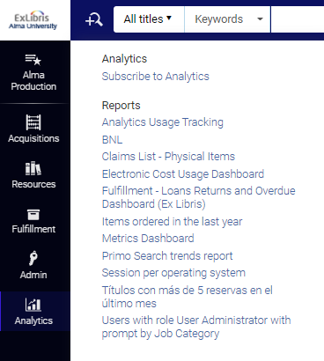
Analytics Consumers
For scheduled reports a user subscribes to the report

Slide 12
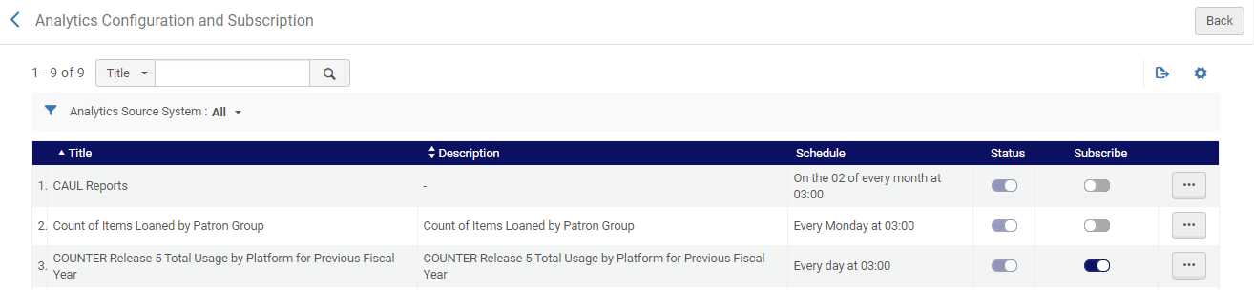
Analytics Consumers
Here the user has subscribed to report “COUNTER Release 5 Total Usage by Platform for Previous Fiscal Year”

Slide 13
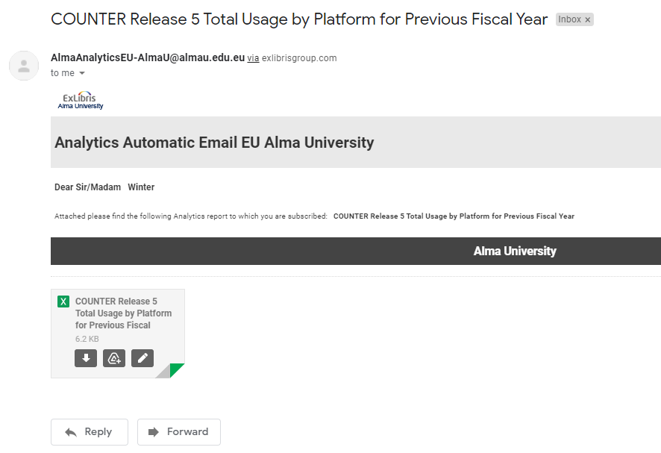
Analytics Consumers
The report is emailed to the subscribed user

Slide 14
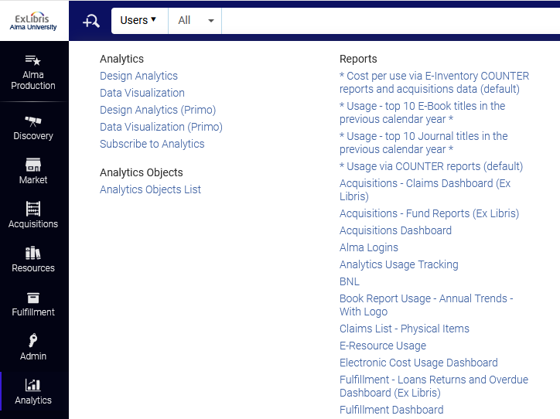
Analytics Consumers
Dashboards and reports can be access from the “Reports” section of the analytics menu.
Reports and dashboards will appear according to the roles assigned to the object and
A dashboard
After clicking a reports or dashboard it will open in a new window.
A report

Slide 15
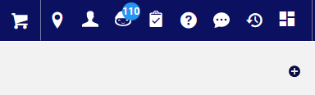
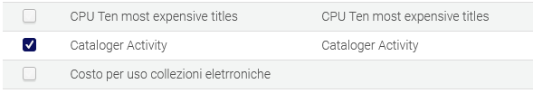
Analytics Consumers
Widgets are added via the + sign on the top right of the Alma landing page
We add the widget called “Cataloger Activity”

Slide 16
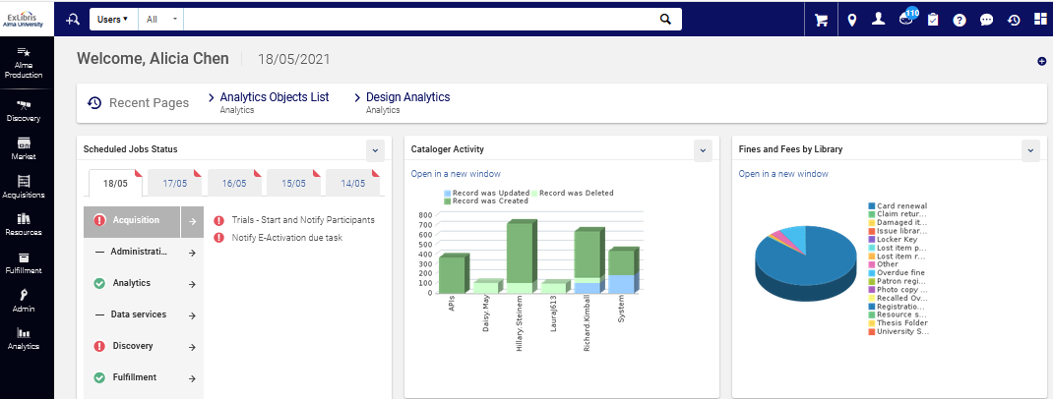
Analytics Consumers
And now the widget appears on the Alma landing page

Slide 17


Analytics Designers

Slide 18
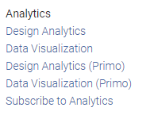
Analytics Designers
As previously mentioned, a user with role “Designs Analytics” can design, create, edit, delete and work on any analytics reports, analysis, dashboards etc., as well as Data Visualization projects
Design Analytics = Will open Alma Analytics
Data Visualization = Will open Alma Data Visualization
Design Analytics (Primo) = Will open Primo Analytics
Data Visualization (Primo) = Will open Primo Data Visualization

Slide 19
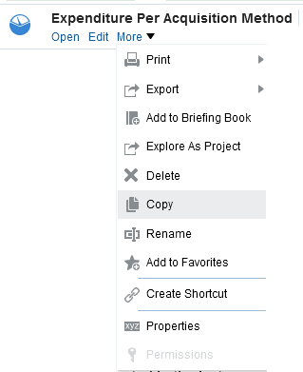
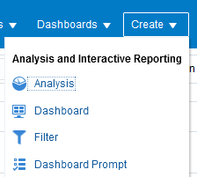
Analytics Designers
Here we have clicked “Design Analytics”. We can
Create a new Analysis (report), Dashboard, Filter and Dashboard Prompt.
Perform multiple operations on existing entities such as reports.

Slide 20
xxx@exlibrisgroup.com

